Slide 1
Convolutional Neural Networks

Slide 2

History
In 1995, Yann introduced the concept of convolutional neural networks.

Slide 3
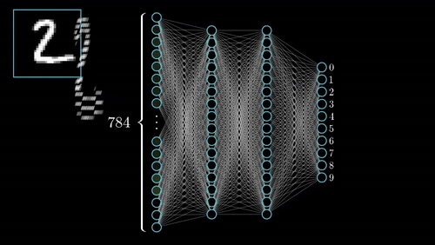
Problems of ANN

Slide 4
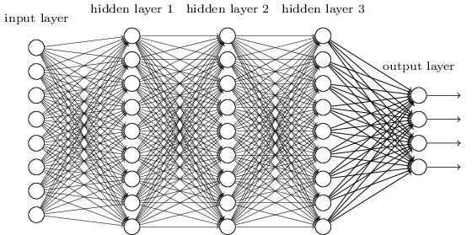
Fully connected Neural Network
From this fully connected model, do we really need all the edges?
Can some of these be shared?
Each pixel is flattened as 1D and feed into input layer
How can we use spatial structure in a input to inform the architecture of the network

Slide 5



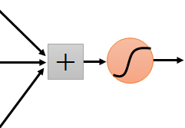
“upper-left beak” detector
They can be compressed
to the same parameters.
“middle beak” detector

Slide 6
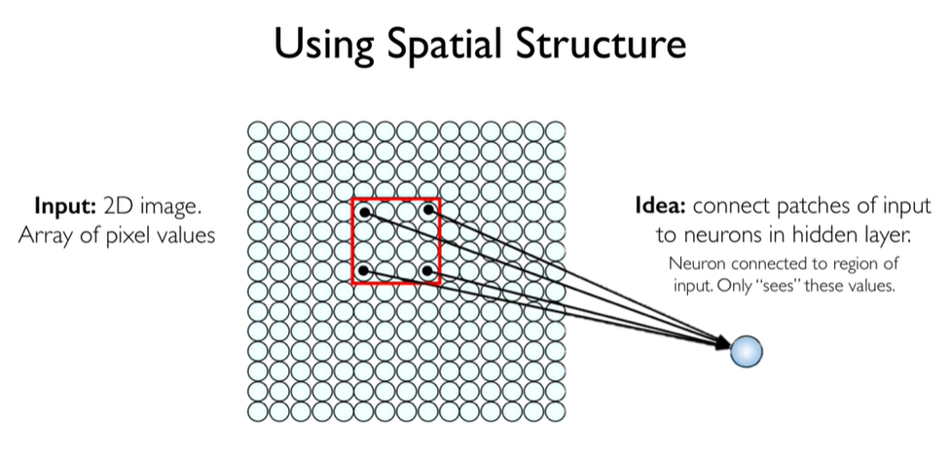

Slide 7
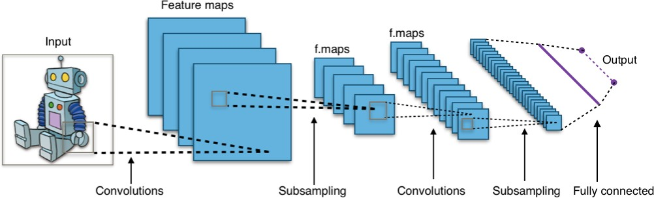
A typical CNN architecture

Slide 8
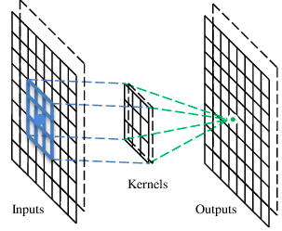
A convolutional layer
A CNN is a neural network with some convolutional layers (and some other layers). A convolutional layer has a number of filters that does convolutional operation.
Beak detector
A filter

Slide 9
Convolution kernels
Each convolutional layer contains a series of filters known as convolutional kernels.
The filter is a matrix of integers that are used on a subset of the input pixel values.
Each pixel is multiplied by the corresponding value in the kernel, then the result is summed up for a single value for simplicity representing a grid cell, like a pixel, in the output channel/feature map.
These are linear transformations, each convolution is a type of affine function.
When multiple convolutional kernels are applied within a convolutional layer, many channels/feature maps are created, one from each convolutional kernel.

Slide 10
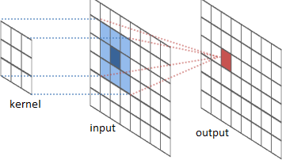
The convolution operation

Slide 11
The convolution operation

Slide 12
Convolution is a mathematical operation that allows the merging of two sets of information.
It’s a specialized kind of liner operation
In the case of CNN, convolution is applied to the input data to filter the information and produce the feature map.
This filter is also called a kernel

Slide 13
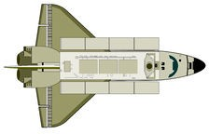
Suppose we are tracking the position of an aeroplane using a laser sensor at discrete time intervals
Now suppose our sensor is noisy
To obtain a less noisy estimate we would like to average several measure- ments
More recent measurements are more important so we would like to take a weighted average
x₀
x₁
x₂
6
s = x
t
Σ
w = (x∗w)
t−a −a
t
a=0
input
filter
convolution

Slide 14
In practice, we would only sum over a small window
6
s = x
w
t
Σ
t−a −a
The weight array (w) is known as the filter
We just slide the filter over the input and compute the value of s_{t} based on a win- dow around x_{t}
a=0
w−6 w−5 w−4 w−3 w−2 w−1 w0
W
X S
0.01 | 0.01 | 0.02 | 0.02 | 0.04 | 0.4 | 0.5
1.00 | 1.10 | 1.20 | 1.40 | 1.70 | 1.80 | 1.90 | 2.10 | 2.20 | 2.40 | 2.50 | 2.70
1.80
s6 = x6w0 + x5w−1 + x4w−2 + x3w−3 + x2w−4 + x1w−5 + x0w−6
4/68

Slide 15
In practice, we would only sum over a small window
6
s = x
w
t
Σ
t−a −a
The weight array (w) is known as the filter
We just slide the filter over the input and compute the value of s_{t} based on a win- dow around x_{t}
a=0
w−6 w−5 w−4 w−3 w−2 w−1 w0
W
X S
0.01 | 0.01 | 0.02 | 0.02 | 0.04 | 0.4 | 0.5
1.00 | 1.10 | 1.20 | 1.40 | 1.70 | 1.80 | 1.90 | 2.10 | 2.20 | 2.40 | 2.50 | 2.70
1.80 | 1.96
s6 = x6w0 + x5w−1 + x4w−2 + x3w−3 + x2w−4 + x1w−5 + x0w−6

Slide 16
In practice, we would only sum over a small window
6
Σ
s = x
w
t
t−a −a
The weight array (w) is known as the filter
We just slide the filter over the input and compute the value of s_{t} based on a win- dow around x_{t}
a=0
w−6 w−5 w−4 w−3 w−2 w−1 w0
W
X S
0.01 | 0.01 | 0.02 | 0.02 | 0.04 | 0.4 | 0.5
1.00 | 1.10 | 1.20 | 1.40 | 1.70 | 1.80 | 1.90 | 2.10 | 2.20 | 2.40 | 2.50 | 2.70
1.80 | 1.96 | 2.11
s6 = x6w0 + x5w−1 + x4w−2 + x3w−3 + x2w−4 + x1w−5 + x0w−6
4/68

Slide 17
In practice, we would only sum over a small window
6
s = x
w
t
Σ
t−a −a
The weight array (w) is known as the filter
We just slide the filter over the input and compute the value of s_{t} based on a win- dow around x_{t}
a=0
w−6 w−5 w−4 w−3 w−2 w−1 w0
W
X S
0.01 | 0.01 | 0.02 | 0.02 | 0.04 | 0.4 | 0.5
1.00 | 1.10 | 1.20 | 1.40 | 1.70 | 1.80 | 1.90 | 2.10 | 2.20 | 2.40 | 2.50 | 2.70
1.80 | 1.96 | 2.11 | 2.16
s6 = x6w0 + x5w−1 + x4w−2 + x3w−3 + x2w−4 + x1w−5 + x0w−6

Slide 18
In practice, we would only sum over a small window
6
s = x
w
t
Σ
t−a −a
The weight array (w) is known as the filter
We just slide the filter over the input and compute the value of s_{t} based on a win- dow around x_{t}
a=0
w−6 w−5 w−4 w−3 w−2 w−1 w0
W
X S
0.01 | 0.01 | 0.02 | 0.02 | 0.04 | 0.4 | 0.5
1.00 | 1.10 | 1.20 | 1.40 | 1.70 | 1.80 | 1.90 | 2.10 | 2.20 | 2.40 | 2.50 | 2.70
1.80 | 1.96 | 2.11 | 2.16 | 2.28
s6 = x6w0 + x5w−1 + x4w−2 + x3w−3 + x2w−4 + x1w−5 + x0w−6

Slide 19
In practice, we would only sum over a small window
6
s = x
w
t
Σ
t−a −a
The weight array (w) is known as the filter
We just slide the filter over the input and compute the value of s_{t} based on a win- dow around x_{t}
a=0
w−6 w−5 w−4 w−3 w−2 w−1 w0
W
X S
0.01 | 0.01 | 0.02 | 0.02 | 0.04 | 0.4 | 0.5
1.00 | 1.10 | 1.20 | 1.40 | 1.70 | 1.80 | 1.90 | 2.10 | 2.20 | 2.40 | 2.50 | 2.70
1.80 | 1.96 | 2.11 | 2.16 | 2.28 | 2.42
s6 = x6w0 + x5w−1 + x4w−2 + x3w−3 + x2w−4 + x1w−5 + x0w−6

Slide 20
In practice, we would only sum over a small window
6
s = x
w
t
Σ
t−a −a
The weight array (w) is known as the filter
We just slide the filter over the input and compute the value of s_{t} based on a win- dow around x_{t}
Here the input (and the kernel) is one dimensional
a=0
w−6 w−5 w−4 w−3 w−2 w−1 w0
W
0.01 | 0.01 | 0.02 | 0.02 | 0.04 | 0.4 | 0.5
X
S
1.00 | 1.10 | 1.20 | 1.40 | 1.70 | 1.80 | 1.90 | 2.10 | 2.20 | 2.40 | 2.50 | 2.70
1.80 | 1.96 | 2.11 | 2.16 | 2.28 | 2.42
s6 = x6w0 + x5w−1 + x4w−2 + x3w−3 + x2w−4 + x1w−5 + x0w−6

Slide 21
In practice, we would only sum over a small window
6
s = x
w
t
Σ
t−a −a
The weight array (w) is known as the filter
We just slide the filter over the input and compute the value of s_{t} based on a win- dow around x_{t}
Here the input (and the kernel) is one dimensional
Can we use a convolutional operation on a 2D input also?
a=0
w−6 w−5 w−4 w−3 w−2 w−1 w0
W
0.01 | 0.01 | 0.02 | 0.02 | 0.04 | 0.4 | 0.5
X
1.00 | 1.10 | 1.20 | 1.40 | 1.70 | 1.80 | 1.90 | 2.10 | 2.20 | 2.40 | 2.50 | 2.70
S
1.80 | 1.96 | 2.11 | 2.16 | 2.28 | 2.42
s6 = x6w0 + x5w−1 + x4w−2 + x3w−3 + x2w−4 + x1w−5 + x0w−6
4/68

Slide 22
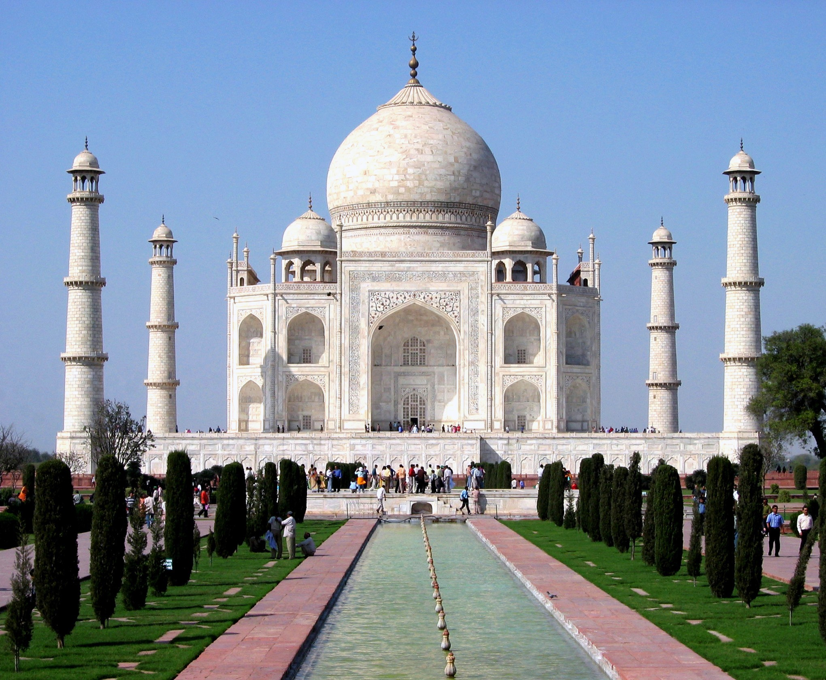
We can think of images as 2D inputs
5/68

Slide 23
We can think of images as 2D inputs
We would now like to use a 2D filter (m × n)

Slide 24
We can think of images as 2D inputs
We would now like to use a 2D filter (m × n)
First let us see what the 2D formula looks like
m−1 n−1
S = (I ∗ K) =
Σ Σ
I
K
ij
ij
i−a,j−b a,b
a=0 b=0

Slide 25
We can think of images as 2D inputs
We would now like to use a 2D filter (m × n)
First let us see what the 2D formula looks like
This formula looks at all the preced- ing neighbours (i − a, j − b)
m−1 n−1
S = (I ∗ K) =
Σ Σ
I
K
ij
ij
i−a,j−b a,b
a=0 b=0

Slide 26
We can think of images as 2D inputs
We would now like to use a 2D filter (m × n)
First let us see what the 2D formula looks like
This formula looks at all the preced- ing neighbours (i − a, j − b)
In practice, we use the following for- mula which looks at the succeeding neighbours
m−1 n−1
S = (I ∗ K) =
Σ Σ
I
K
ij
ij
i+a,j+b a,b
a=0 b=0

Slide 27
Let us apply this idea to a toy ex- ample and see the results

Slide 28
Let us apply this idea to a toy ex- ample and see the results
Input
a | b | c | d
e | f | g | h
i | j | k | l
Kernel
w | x
y | z
Output
aw+bx+ey+fz

Slide 29
Let us apply this idea to a toy ex- ample and see the results
Input
a | b | c | d
e | f | g | h
i | j | k | l
Kernel
w | x
y | z
Output
aw+bx+ey+fz | bw+cx+fy+gz

Slide 30
Let us apply this idea to a toy ex- ample and see the results
Input
a | b | c | d
e | f | g | h
i | j | k | l
Kernel
w | x
y | z
Output
aw+bx+ey+fz | bw+cx+fy+gz | cw+dx+gy+hz

Slide 31
Let us apply this idea to a toy ex- ample and see the results
Input
a | b | c | d
e | f | g | h
i | j | k | l
Kernel
w | x
y | z
Output
aw+bx+ey+fz | bw+cx+fy+gz | cw+dx+gy+hz
ew+fx+iy+jz

Slide 32
Let us apply this idea to a toy ex- ample and see the results
Input
a | b | c | d
e | f | g | h
i | j | k | l
Kernel
w | x
y | z
Output
aw+bx+ey+fz | bw+cx+fy+gz | cw+dx+gy+hz
ew+fx+iy+jz | fw+gx+jy+kz

Slide 33
Let us apply this idea to a toy ex- ample and see the results
Input
a | b | c | d
e | f | g | h
i | j | k | l
Kernel
w | x
y | z
Output
aw+bx+ey+fz | bw+cx+fy+gz | cw+dx+gy+hz
ew+fx+iy+jz | fw+gx+jy+kz | gw+hx+ky+lz

Slide 34
Let us see some examples of 2D convolutions applied to images

Slide 35

1 1 1
∗ 1 1 1 =
1 1 1

Slide 36

1 1 1
∗ 1 1 1 =
1 1 1
blurs the image

Slide 37
0 -1 0
∗ -1 5 -1 =
0 -1 0

Slide 38
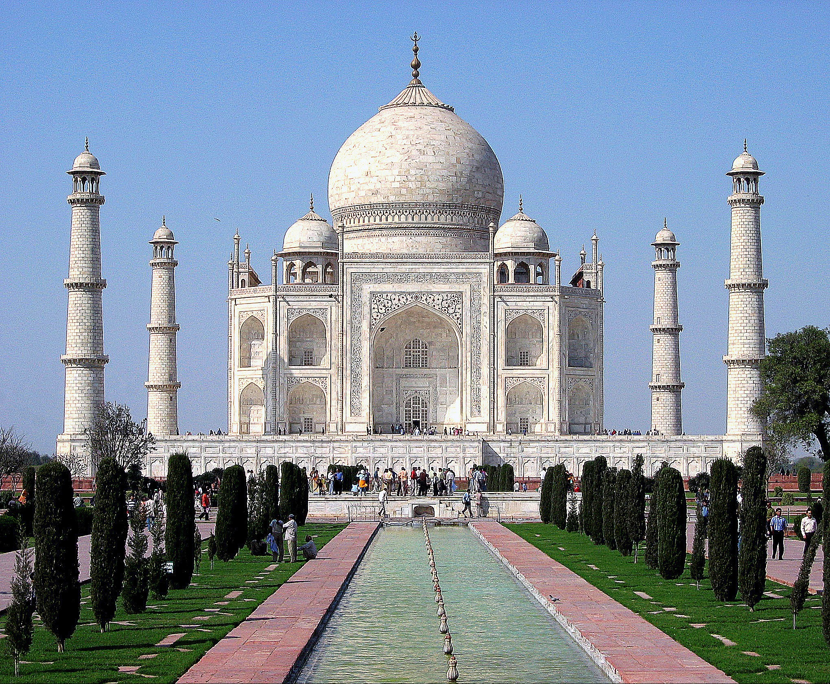
0 -1 0
∗ -1 5 -1 =
0 -1 0
sharpens the image

Slide 39
1 1 1
∗ 1 -8 1 =
1 1 1

Slide 40
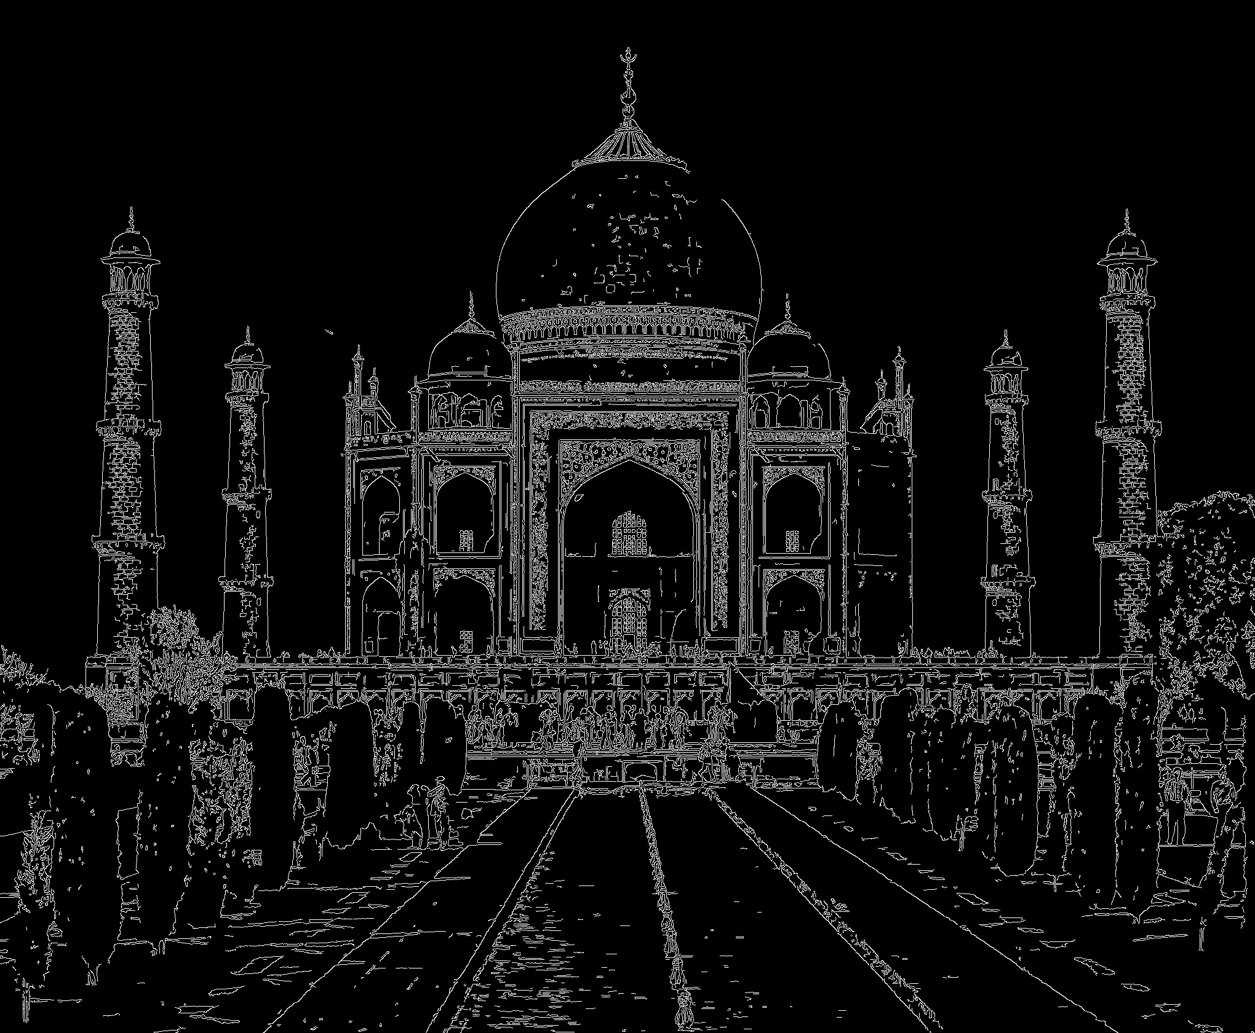
1 1 1
∗ 1 -8 1 =
1 1 1
detects the edges

Slide 41


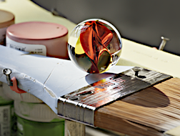





Kernels and Convolution
Blur
Sharpen
Brighten
Darken
Original Image
Notes:
Before we get into neural networks, lets talk about how Computer Vision experts used to approach this type of problem. If you played with Photoshop, MS Paint, or GIMP a lot as a kid making .gifs or memes or stilly pictures: good news! Understanding how computers represent and manipulate photos is a great foundation for modern day computer vision.
For example, let’s look at the blur, sharpen, brighten and darken tools. In a drawing program, the area around where we click that manipulates our image is called the kernel. Convolution is when our kernel is multiplied with our image, and that is what’s happening when we select these tools and drag it across our image. To be technical, convolution is when we apply one function to another function, but we can think of our base image as a function of color, and our kernel as a function of pixels.

Slide 42
Kernels and Convolution
Blur
.06 | .13 | .06
.13 | .25 | .13
.06 | .13 | .06
Sharpen
0 | -1 | 0
-1 | 5 | -1
0 | -1 | 0
Brighten
0 | 0 | 0
0 | 1.5 | 0
0 | 0 | 0
Darken
0 | 0 | 0
0 | 0.5 | 0
0 | 0 | 0
Original Image
Notes:
The kernel is just a small matrix, blurring is a weighted averaging of the numbers that represent the pixels. Sharpen brightens the pixel in the center of it, but subtracts the pixels directly adjacent to it. Brighten makes the center pixel’s color values bigger (if 255 is white) or smaller (if 0 is white). Darken does the opposite. Let’s take a look at a smaller image and break it down.

Slide 43
We will now see a working example of 2D convolution.

Slide 44
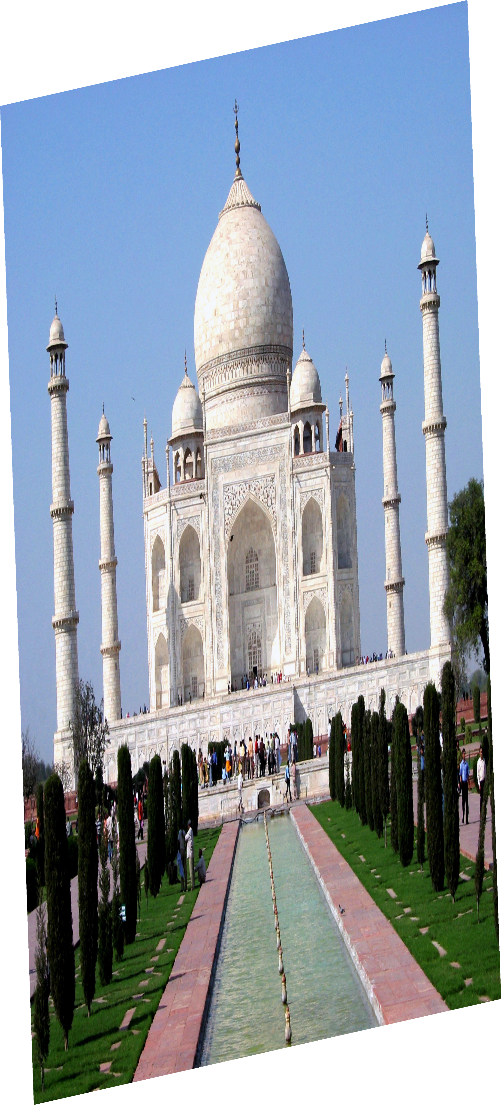
We just slide the kernel over the input image

Slide 45
We just slide the kernel over the input image
Each time we slide the kernel we get one value in the output

Slide 46
We just slide the kernel over the input image
Each time we slide the kernel we get one value in the output

Slide 47
We just slide the kernel over the input image
Each time we slide the kernel we get one value in the output
13/68

Slide 48
We just slide the kernel over the input image
Each time we slide the kernel we get one value in the output

Slide 49
We just slide the kernel over the input image
Each time we slide the kernel we get one value in the output

Slide 50
We just slide the kernel over the input image
Each time we slide the kernel we get one value in the output

Slide 51
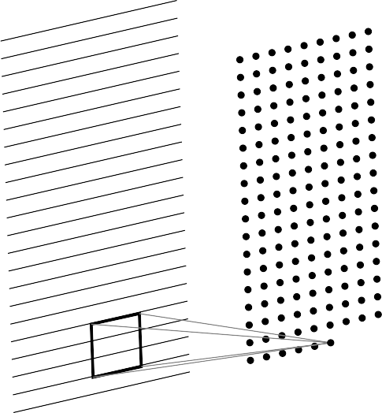
We just slide the kernel over the input image
Each time we slide the kernel we get one value in the output

Slide 52
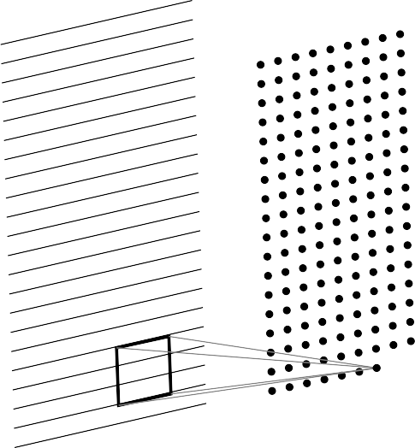
We just slide the kernel over the input image
Each time we slide the kernel we get one value in the output

Slide 53
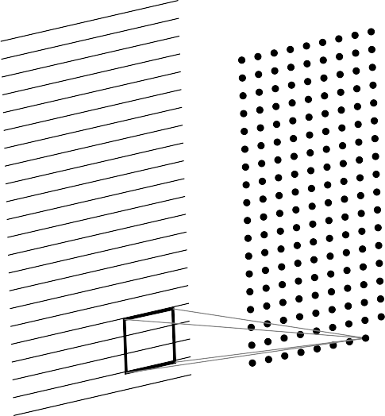
We just slide the kernel over the input image
Each time we slide the kernel we get one value in the output

Slide 54
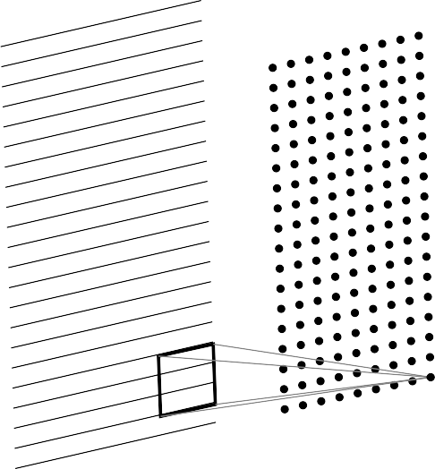
We just slide the kernel over the input image
Each time we slide the kernel we get one value in the output

Slide 55
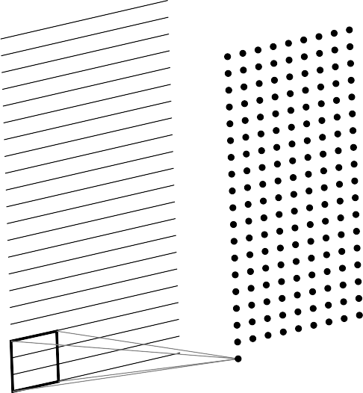
We just slide the kernel over the input image
Each time we slide the kernel we get one value in the output

Slide 56
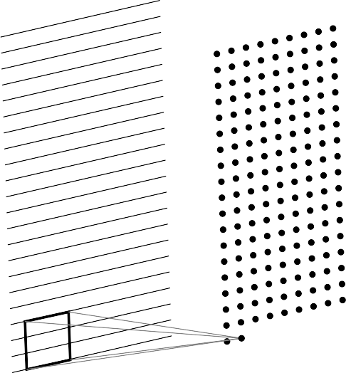
We just slide the kernel over the input image
Each time we slide the kernel we get one value in the output

Slide 57
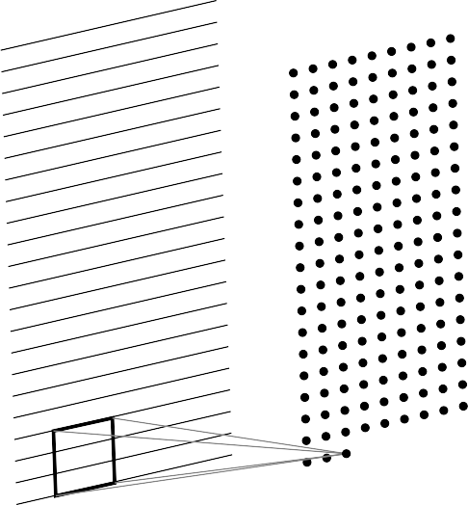
We just slide the kernel over the input image
Each time we slide the kernel we get one value in the output

Slide 58
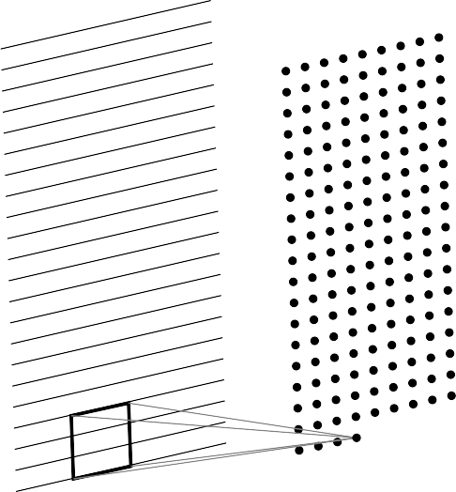
We just slide the kernel over the input image
Each time we slide the kernel we get one value in the output

Slide 59
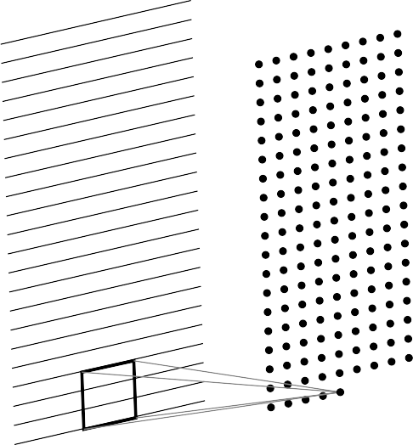
We just slide the kernel over the input image
Each time we slide the kernel we get one value in the output

Slide 60
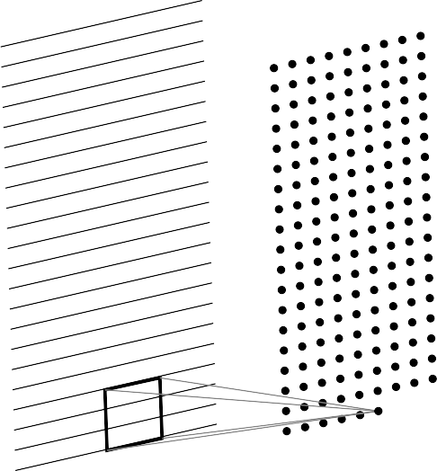
We just slide the kernel over the input image
Each time we slide the kernel we get one value in the output
13/68

Slide 61
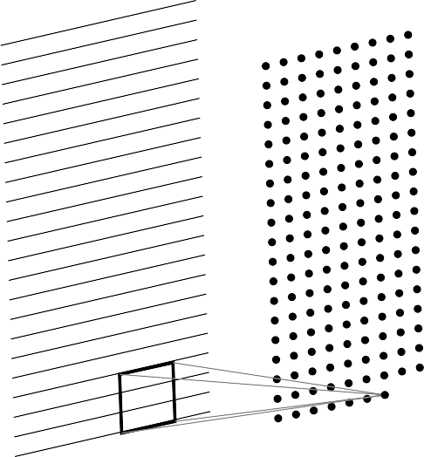
We just slide the kernel over the input image
Each time we slide the kernel we get one value in the output

Slide 62
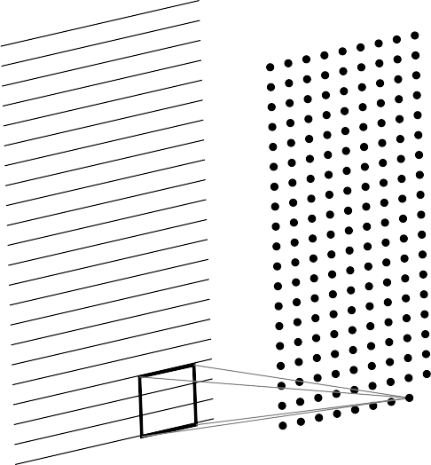
We just slide the kernel over the input image
Each time we slide the kernel we get one value in the output

Slide 63
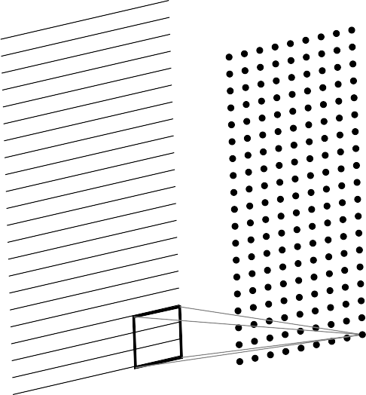
We just slide the kernel over the input image
Each time we slide the kernel we get one value in the output
The resulting output is called a fea- ture map.

Slide 64

We just slide the kernel over the input image
Each time we slide the kernel we get one value in the output
The resulting output is called a fea- ture map.
We can use multiple filters to get mul- tiple feature maps.

Slide 65
Question
In the 1D case, we slide a one dimensional filter over a one dimensional input

Slide 66
Question
In the 1D case, we slide a one dimensional filter over a one dimensional input
A | B | C | B | A | B | C

Slide 67
Question
In the 1D case, we slide a one dimensional filter over a one dimensional input
A | B | C | B | A | B | C

Slide 68
Question
In the 1D case, we slide a one dimensional filter over a one dimensional input
A | B | C | B | A | B | C

Slide 69
Question
In the 1D case, we slide a one dimensional filter over a one dimensional input
A | B | C | B | A | B | C

Slide 70
Question
In the 1D case, we slide a one dimensional filter over a one dimensional input
A | B | C | B | A | B | C

Slide 71
Question
In the 1D case, we slide a one dimensional filter over a one dimensional input
In the 2D case, we slide a two dimen- stional filter over a two dimensional out- put

Slide 72
a | b | c | d
e | f | g | h
i | j | k | l
Question
In the 1D case, we slide a one dimensional filter over a one dimensional input
In the 2D case, we slide a two dimen- stional filter over a two dimensional out- put

Slide 73
a | b | c | d
e | f | g | h
i | j | k | l
Question
In the 1D case, we slide a one dimensional filter over a one dimensional input
In the 2D case, we slide a two dimen- stional filter over a two dimensional out- put

Slide 74
a | b | c | d
e | f | g | h
i | j | k | l
Question
In the 1D case, we slide a one dimensional filter over a one dimensional input
In the 2D case, we slide a two dimen- stional filter over a two dimensional out- put

Slide 75
a | b | c | d
e | f | g | h
i | j | k | l
Question
In the 1D case, we slide a one dimensional filter over a one dimensional input
In the 2D case, we slide a two dimen- stional filter over a two dimensional out- put

Slide 76
a | b | c | d
e | f | g | h
i | j | k | l
Question
In the 1D case, we slide a one dimensional filter over a one dimensional input
In the 2D case, we slide a two dimen- stional filter over a two dimensional out- put

Slide 77
a | b | c | d
e | f | g | h
i | j | k | l
Question
In the 1D case, we slide a one dimensional filter over a one dimensional input
In the 2D case, we slide a two dimen- stional filter over a two dimensional out- put

Slide 78
Question
In the 1D case, we slide a one dimensional filter over a one dimensional input
In the 2D case, we slide a two dimen- stional filter over a two dimensional out- put
What would happen in the 3D case?

Slide 79
R G B
What would a 3D filter look like?
INPUT

Slide 80
R G B
What would a 3D filter look like?
It will be 3D and we will refer to it as a volume
filter
INPUT

Slide 81
What would a 3D filter look like?
R G B
It will be 3D and we will refer to it as a volume
Once again we will slide the volume over the 3D input and compute the convolution oper- ation
OUTPUT
INPUT

Slide 82
What would a 3D filter look like?
R G B
It will be 3D and we will refer to it as a volume
Once again we will slide the volume over the 3D input and compute the convolution oper- ation
OUTPUT
INPUT

Slide 83
What would a 3D filter look like?
R G B
It will be 3D and we will refer to it as a volume
Once again we will slide the volume over the 3D input and compute the convolution oper- ation
OUTPUT
INPUT

Slide 84
What would a 3D filter look like?
R G B
It will be 3D and we will refer to it as a volume
Once again we will slide the volume over the 3D input and compute the convolution oper- ation
OUTPUT
INPUT

Slide 85
What would a 3D filter look like?
R G B
It will be 3D and we will refer to it as a volume
Once again we will slide the volume over the 3D input and compute the convolution oper- ation
OUTPUT
INPUT

Slide 86
What would a 3D filter look like?
R G B
It will be 3D and we will refer to it as a volume
Once again we will slide the volume over the 3D input and compute the convolution oper- ation
OUTPUT
INPUT

Slide 87
What would a 3D filter look like?
R G B
It will be 3D and we will refer to it as a volume
Once again we will slide the volume over the 3D input and compute the convolution oper- ation
OUTPUT
INPUT

Slide 88
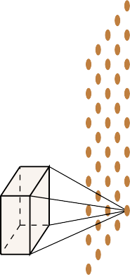
What would a 3D filter look like?
R G B
It will be 3D and we will refer to it as a volume
Once again we will slide the volume over the 3D input and compute the convolution oper- ation
OUTPUT
INPUT

Slide 89
What would a 3D filter look like?
R G B
It will be 3D and we will refer to it as a volume
Once again we will slide the volume over the 3D input and compute the convolution oper- ation
OUTPUT
INPUT

Slide 90
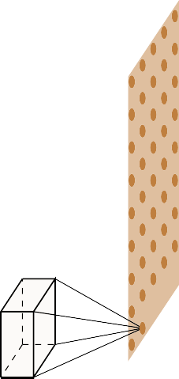
What would a 3D filter look like?
R G B
It will be 3D and we will refer to it as a volume
Once again we will slide the volume over the 3D input and compute the convolution oper- ation
OUTPUT
INPUT
15/68

Slide 91
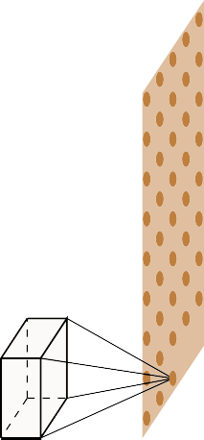
What would a 3D filter look like?
R G B
It will be 3D and we will refer to it as a volume
Once again we will slide the volume over the 3D input and compute the convolution oper- ation
OUTPUT
INPUT

Slide 92
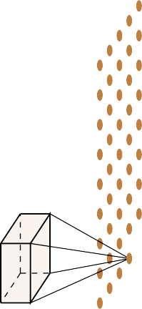
What would a 3D filter look like?
R G B
It will be 3D and we will refer to it as a volume
Once again we will slide the volume over the 3D input and compute the convolution oper- ation
OUTPUT
INPUT

Slide 93
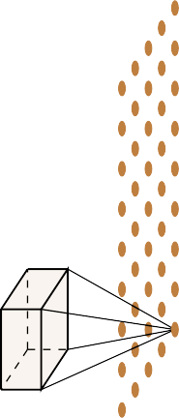
What would a 3D filter look like?
R G B
It will be 3D and we will refer to it as a volume
Once again we will slide the volume over the 3D input and compute the convolution oper- ation
Note that in this lecture we will assume that the filter always extends to the depth of the image
OUTPUT
INPUT

Slide 94

What would a 3D filter look like?
R G B
It will be 3D and we will refer to it as a volume
Once again we will slide the volume over the 3D input and compute the convolution oper- ation
Note that in this lecture we will assume that the filter always extends to the depth of the image
In effect, we are doing a 2D convolution oper- ation on a 3D input (because the filter moves along the height and the width but not along the depth)
OUTPUT
INPUT

Slide 95
What would a 3D filter look like?
R G B
It will be 3D and we will refer to it as a volume
Once again we will slide the volume over the 3D input and compute the convolution oper- ation
Note that in this lecture we will assume that the filter always extends to the depth of the image
In effect, we are doing a 2D convolution oper- ation on a 3D input (because the filter moves along the height and the width but not along the depth)
As a result the output will be 2D (only width and height, no depth)
OUTPUT
INPUT

Slide 96
What would a 3D filter look like?
R G B
It will be 3D and we will refer to it as a volume
Once again we will slide the volume over the 3D input and compute the convolution oper- ation
Note that in this lecture we will assume that the filter always extends to the depth of the image
In effect, we are doing a 2D convolution oper- ation on a 3D input (because the filter moves along the height and the width but not along the depth)
As a result the output will be 2D (only width and height, no depth)
Once again we can apply multiple filters to get
OUTPUT
INPUT
multiple feature maps

